Slide 1

Project for Wireless Mesh network channel assignment
CSE 812
Xiaoyan Li

Slide 2

Wireless Mesh network-multi-channel-unicast

Slide 3
Outline
Analyze issues
Second problem
Mesh network problems
Channel assignment design issues
Link optimization methods
Comparison of channel assignment approaches
Identify problem
First problem

Slide 4

Mesh network problems
Network performance metric
Link optimization
Interference problem
Mesh network optimization
Load topology
Routing approaches
Static or dynamic

Slide 5

Mesh Network optimization
Internet

Slide 6
Is minimizing inference the same as maximizing traffic?
Internet
Channel B
Channel A
Channel C
Channel A
Channel C
Link removal also results in graph partition, channel assignment and routing approach problems
Hassen A, Mohamed O, Shamala S, Nor A, 2016

Slide 7
Link optimization methods
Spanning tree link optimization
Raniwala and Chiueh, 2005; Kim and Suh, 2010
Traffic profile link optimization
Skalli et al., 2007; Subramanian et al., 2008
Flow-based link optimization
Chiu et al., 2009; Mogaibel et al., 2012
Power control link optimization
Chaudhry et al., 2012
High quality metric link optimization
Draves et al. 2004

Slide 8
Interference
Channel 1
Channel 1
Node A
Node B
Node C
Channel 1
Intra-flow interference
Node A
Node B
Channel 1
Node C
Channel 1
Channel 1
Node C
Node D
Hidden node inference
Inter-flow inference
Node A
Node B
Node D
External source
External source inference
Rate inference
High rate Channel 1
Channel 1
Channel 1
Node A
Node B
Low rate Channel 1
Node C
Node D
Node C
Node D

Slide 9
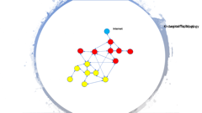
Load topology
Logic topology
Interference
Traffic topology
Routing strategy

Slide 10

Known traffic Topology
Logical Topology
Internet
Internet

Slide 11
Static or Dynamic
Load
Dynamic or static
Dynamic load
Static load
Logic graph
Static solution
Logic graph dynamic
Logic graph static
routing
routing
Routing dynamic
Routing static
Routing dynamic
Routing static

Slide 12
Static or Dynamic
Static
Dynamic
Flow response
Easy to implement
Flexible
No response time
Response time
Stable
Optimize capacity

Slide 13
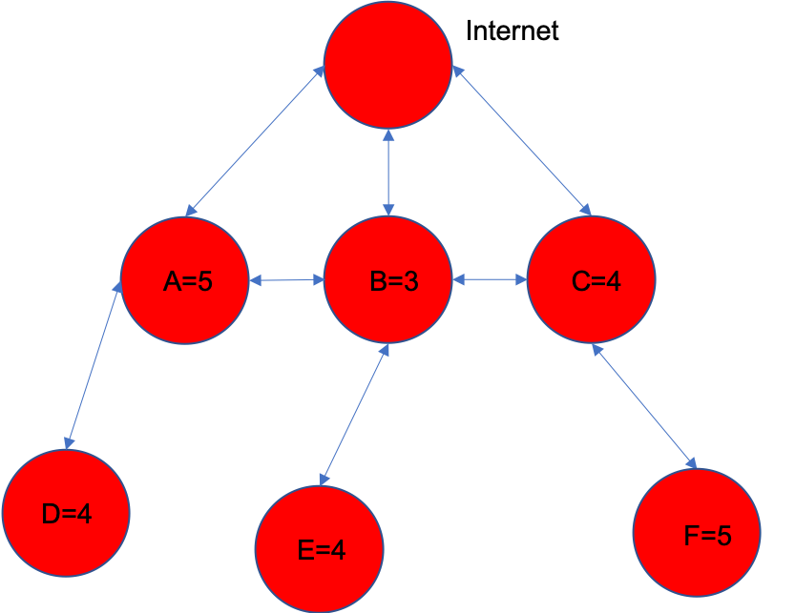
What is the good measure?
Channel 1
Node A
Node B
Min interference
High flow median
High network capacity
High total flow
Channel 1
Node C
Node D
Internet
A
B
C
Internet
A
B
C
F = 5
F = 4
F = 3
T = 5
T = 4
T = 3
D
E
F

Slide 14

Disagreement
Disconnect network
Connectivity
Broken nodes
Determined by logic and load topology
Fault tolerance
Routing
Client
Stability
Join and switch nodes
Load topology change

Slide 15
Comparison of channel assignment approaches
Channel inference index
Connectivity-aware
Routing aware
Joint multicast routing

Slide 16
Channel inference index ammproach
Interference-aware channel assignment
Minimize the total network inference which refers to the number of nodes/links sharing the same channel
Traffic-aware channel assignment
Load of each link is monitored, and the channel of congested link is updated by channel with least load
Throughput-aware channel assignment
Sum of the end-to-end throughput of all flows used as channel assignment index. Maximize the total throughput between all pairs of nodes
QoS-aware channel assignment
Packet drop and blocking probability was used as metric to quantify performance of a channel. This metric is used to reduce transmission delay.
Capacity/data rate aware
Actual link capacity in a WMN by considering the congestions over all links was calculated and used to indicate the impact on global network performance of a single link

Slide 17
Connectivity-aware channel assignment

Slide 18
Joint Routing and channel assignment approaches
Joint unicast and channel assignment approaches
Hyacinth-based Channel Assignment
Raniwala and Chiueh (2005)
Load Aware Channel Assignment
Raniwala et al. (2004)
Maxflow-based Centralized Channel Assignment
Skalli et al. (2007)
Distributed Congestion-Aware Channel Assignment
Mohsenian Rad and Wong (2009)
Cluster-based joint Channel Assignment and Routing Protocol
Mettali Gammar and Ghannay (2005)

Slide 19
Joint Routing and channel assignment approaches
Joint unicast and channel assignment approaches
Robust Channel Assignment and Routing with Time Partitioning
Wellons and Xue ( 2014)
Joint Qos Routing and Channel Assignment
Bakhshi et al. (2011)
Joint Routing， Channel Assignment and Rate allocation
Glvez and Ruiz (2013)
Link Scheduling Rate Allocation, Routing and Channel Assignment
Glvez and Ruiz (2015)
On-demand-Based Channel Assignment
Gong et al. (2009)

Slide 20
Joint Routing and channel assignment approaches
Joint multicast routing and channel assignment
Utility-based Channel Assignment
Kumar et al. (2013)
Distributed polynomial-time Priority-aware Channel Assignment
Lin and Zhuang (2013）
I-QCA
Chakraborty (2015)
Cross-Layered and Load-Oriented Multicast Routing and Channel Assignment
Yang and Hong (2014)
Multi-objective Genetic Approach
Vaezpour and Dehghan (2013)
Level-based Channel Assignment
Zeng et al. (2010)
Quality o分Service Multicast Routing Channel Assignment
Cheng and Yang (2011)
Learning Automata Multi-Casting Routing algorithm
Pediaditaki et al. (2009)

Slide 21
Not tested methods
Max flow
Min response time
Topology in graph connection
Graph Theory
Topology method
Graph Neural Networks
Matrix analysis method
Nonconvex optimization
Degree matrix

Slide 22





PROJECT TIMELINE
Mesh Networks Channel Assignment Group
2020-4-30
HEADING
Prepare for the final presentation and submit the report. Celebrate!
2020-3-20
2020-4-20
HEADING
HEADING
Implement and debug the method and simulate on random graph situations. Think of improvement possibilities of the method.
Discuss improvement possibility and write project report and think about what is learned in this project.
2020-3-4
HEADING
Read articles about related work and make decision of method for project question.
2020-4-5
HEADING
Summarize experiment results and compare the results with existing methods. Analyze the reason of the performance difference.

Slide 23

References
Bahl, Paramvir, Ranveer Chandra, and John Dunagan. 2004. “SSCH.” Proceedings of the 10th Annual International Conference on Mobile Computing and Networking - MobiCom ’04. https://doi.org/10.1145/1023720.1023742.
Beheshtifard, Ziaeddin, and Mohammad Reza Meybodi. 2018. “An Adaptive Channel Assignment in Wireless Mesh Network: The Learning Automata Approach.” Computers & Electrical Engineering 72 (November): 79–91.
Bongsu, Raja Hasyifah Raja, Abdullah Mohammed, and Mohamad Afendee Mohamed. n.d. “Recent Trends in Channel Assignment Algorithms for Multi-Radio Multi-Channel in Wireless Mesh Network.” https://pdfs.semanticscholar.org/b6a6/810ecda50bcdbb9386d1f7f9a64006da3090.pdf.
Cheng, Hongju, Naixue Xiong, Athanasios V. Vasilakos, Laurence Tianruo Yang, Guolong Chen, and Xiaofang Zhuang. 2012. “Nodes Organization for Channel Assignment with Topology Preservation in Multi-Radio Wireless Mesh Networks.” Ad Hoc Networks. https://doi.org/10.1016/j.adhoc.2011.02.004.
Ding, Yong, Yi Huang, Guokai Zeng, and Li Xiao. 2008. “Channel Assignment with Partially Overlapping Channels in Wireless Mesh Networks.” In Proceedings of the 4th Annual International Conference on Wireless Internet, 38. ICST (Institute for Computer Sciences, Social-Informatics and Telecommunications Engineering

Slide 24
References
Duarte, P. B. F., Z. M. Fadlullah, A. V. Vasilakos, and N. Kato. 2012. “On the Partially Overlapped Channel Assignment on Wireless Mesh Network Backbone: A Game Theoretic Approach.” IEEE Journal on Selected Areas in Communications 30 (1): 119–27.
Du, P., W. Jia, L. Huang, and W. Lu. 2007. “Centralized Scheduling and Channel Assignment in Multi-Channel Single-Transceiver WiMax Mesh Network.” In 2007 IEEE Wireless Communications and Networking Conference, 1734–39.
Ko, B., V. Misra, J. Padhye, and D. Rubenstein. 2007. “Distributed Channel Assignment in Multi-Radio 802.11 Mesh Networks.” In 2007 IEEE Wireless Communications and Networking Conference, 3978–83. Liu, Y., R. Venkatesan, and C. Li. 2009. “Channel Assignment Exploiting Partially Overlapping Channels for Wireless Mesh Networks.” In GLOBECOM 2009 - 2009 IEEE Global Telecommunications Conference, 1–5.
Meng, X., K. Tan, and Q. Zhang. 2006. “Joint Routing and Channel Assignment in Multi-Radio Wireless Mesh Networks.” In 2006 IEEE International Conference on Communications, 8:3596–3601.
Mogaibel, Hassen A., Mohamed Othman, Shamala Subramaniam, and Nor Asilah Wati Abdul Hamid. 2016. “Review of Channel Assignment Approaches in Multi-Radio Multi-Channel Wireless Mesh Network.” Journal of Network and Computer Applications 72 (September): 113–39.

Slide 25
References
Raniwala, Ashish, Kartik Gopalan, and Tzi-Cker Chiueh. 2004. “Centralized Channel Assignment and Routing Algorithms for Multi-Channel Wireless Mesh Networks.” ACM SIGMOBILE Mobile Computing and Communications Review. https://doi.org/10.1145/997122.997130.
Raniwala, A., and Tzi-cker Chiueh. 2005. “Architecture and Algorithms for an IEEE 802.11-Based Multi-Channel Wireless Mesh Network.” In Proceedings IEEE 24th Annual Joint Conference of the IEEE Computer and Communications Societies., 3:2223–34 vol. 3.
Skalli, H., S. K. Das, L. Lenzini, and M. Conti. 2006. “Traffic and Interference Aware Channel Assignment for Multi-Radio Wireless Mesh Networks.” In Proc. of ACM Int. Conf. on Mobile Comput. and Netw (MOBICOM) Pp, 15–26.
Skalli, H., S. Ghosh, S. K. Das, L. Lenzini, and M. Conti. 2007. “Channel Assignment Strategies for Multiradio Wireless Mesh Networks: Issues and Solutions.” IEEE Communications Magazine 45 (11): 86–95.
Subramanian, A. P., H. Gupta, S. R. Das, and J. Cao. 2008. “Minimum Interference Channel Assignment in Multiradio Wireless Mesh Networks.” IEEE Transactions on Mobile Computing 7 (12): 1459–73.
Wang, J., B. Xie, K. Cai, and D. P. Agrawal. 2007. “Efficient Mesh Router Placement in Wireless Mesh Networks.” In 2007 IEEE International Conference on Mobile Adhoc and Sensor Systems, 1–9.

Slide 26
References
Yin, Z., Z. Li, and M. Chen. 2007. “A Novel Channel Assignment Algorithm for Multicast in Multi-Radio Wireless Mesh Networks.” In 2007 12th IEEE Symposium on Computers and Communications, 283–88.
Zhao, Xiongwen, Siyuan Zhang, Liang Li, Zhaoyan Qu, Yu Zhang, Yi Ding, and Junyu Liu. 2018. “A Multi-Radio Multi-Channel Assignment Algorithm Based on Topology Control and Link Interference Weight for a Power Distribution Wireless Mesh Network.” Wireless Personal Communications 99 (1): 555–66.
Kim, S.-H., Kim, D.-W., Suh, Y.-J., 2011. A cooperative channel assignment protocol for multi-channel multi-rate wireless mesh networks. Ad Hoc Netw. 9, 893–910.
Chiu, H.S., Yeung, K., Lui, K.-S., 2009. J-car: an efficient joint channel assignment and routing protocol for IEEE 802.11-based multi-channel multi-interface mobile ad hoc networks. IEEE Trans. Wirel. Commun. 8, 1706–1715.
Mogaibel, H.A., Othman, M., Subramaniam, S., Hamid, N.A.W.A., 2012. On-demand channel reservation scheme for common traffic in wireless mesh networks. J. Netw. Comput. Appl. 35, 132–151.
Chaudhry, A., Ahmad, N., Hafez, R., 2012. Improving throughput and fairness by improved channel assignment using topology control based on power control for multi-radio multi-channel wireless mesh networks. EURASIP J. Wirel. Commun. Netw. 2012, 1–25.
Draves, R., Padhye, J., Zill, B., 2004. Routing in multi-radio, multi-hop wireless mesh networks. In: Proceedings of the 10th Annual International Conference on Mobile Computing and Networking (MobiCom 04), ACM, New York, NY, USA, pp. 114–128.

